Slide 1
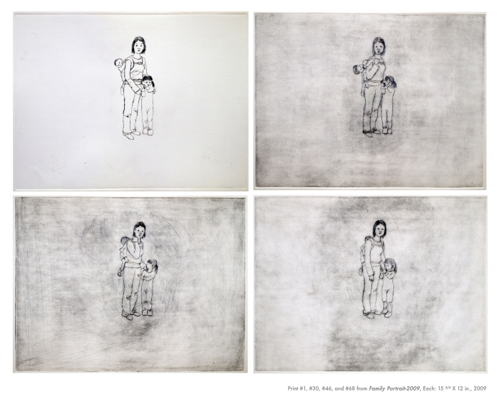
Family Portrait (AKAA_KL)
Medium: 4 prints from a master 157 Prints, Drypoint on Hahnemühle Copperplate bright white paper, B/W, Sound

Slide 2
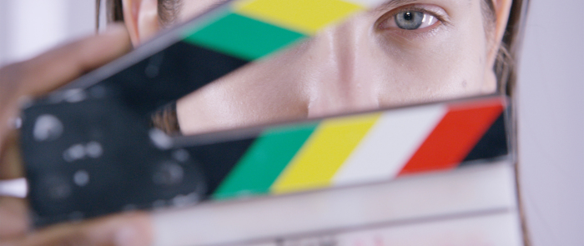
Abduct (AWID_abd15)

Slide 3
After Sun in an Empty Room (AWID_BKaft08)
Oil and alkyd on canvas

Slide 4
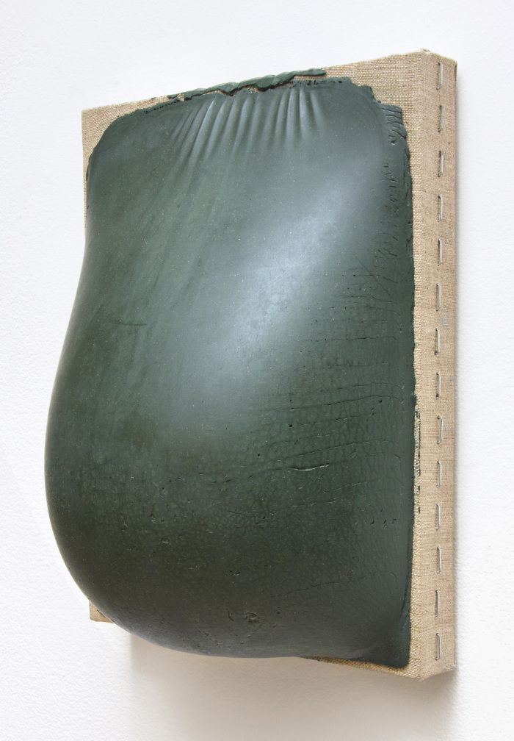
Belly Painting (Green) (AWID_BKbel92)
Encaustic on linen on panel

Slide 5
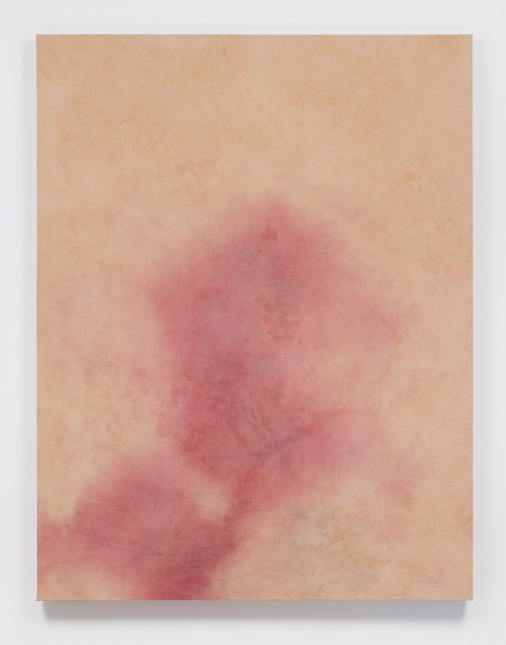
Blue Lift Sandalwood Fall (AWID_BKblu16)
Dyed canvas

Slide 6
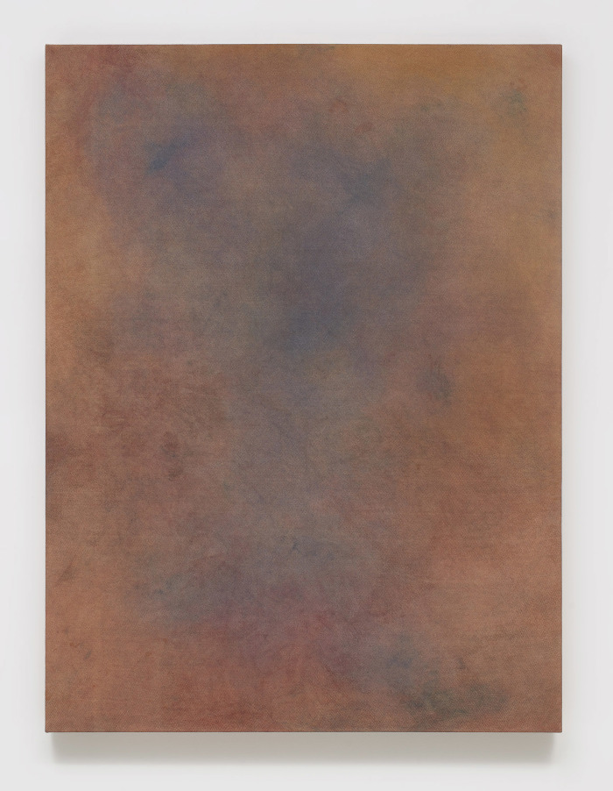
Cosmos Pathos (AWID_BKcos16)
Glue and pigment on dyed canvas

Slide 7
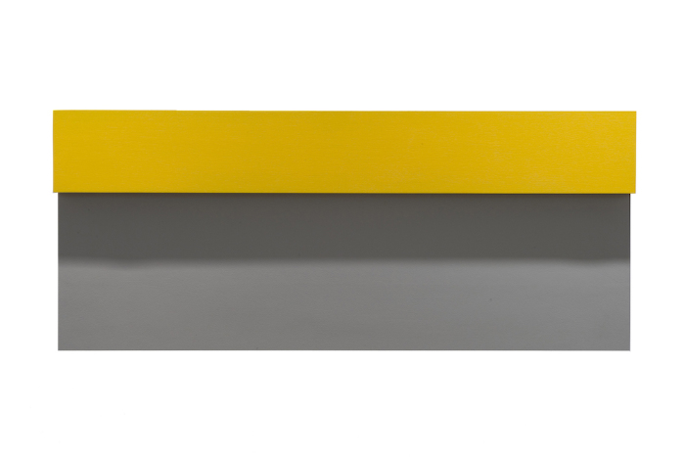
Delacroix's Shadow (AWID_BKdel08)
Flasche on panel and latex; shadow on wall

Slide 8
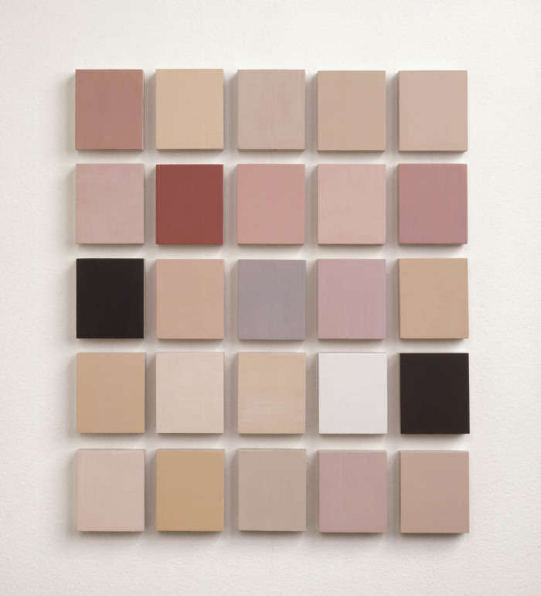
Emmett at Twelve Months #2 (AWID_BKemm94)
Egg tempera on panel

Slide 9
Koryo Dynasty Cup With Dragon head Handle (AWID_BKkor94)
Oil on linen

Slide 10
Miss Mushiniski (First Big Crush) (AWID_BKmis94)
Oil on linen

Slide 11
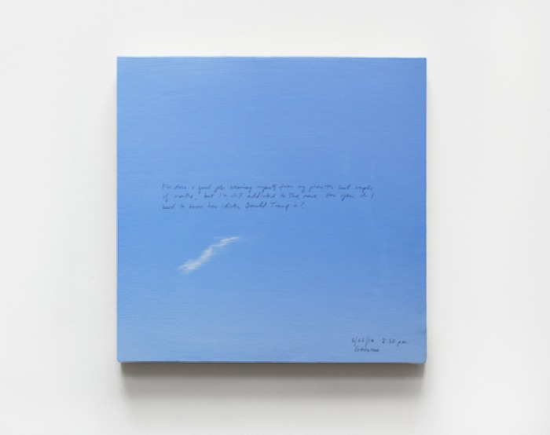
Sunday Painting 10/11/15 (AWID_BKsun15)
Acrylic and pen on canvas mounted on panel

Slide 12
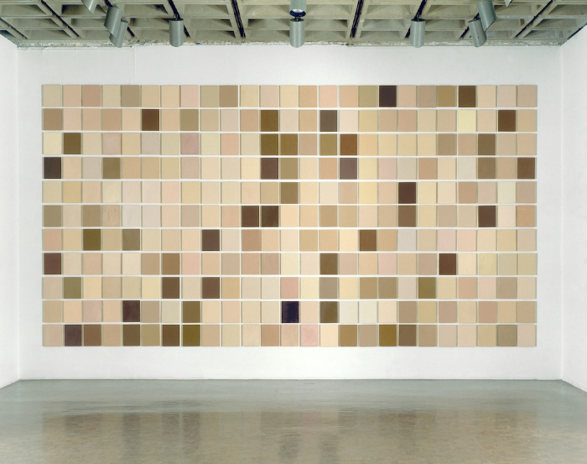
Synecdoche (AWID_BKsyn99)
Oil and wax on panel

Slide 13
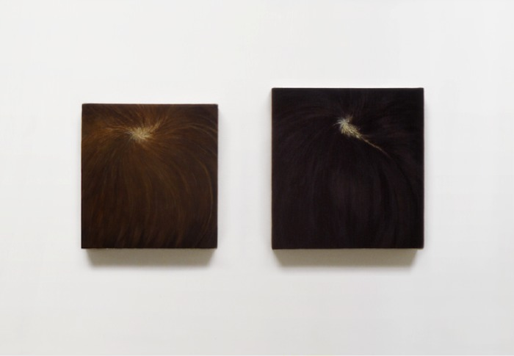
Whorl (Emma & Emmett) (AWID_BKwho)
Egg tempera on panel

Slide 14
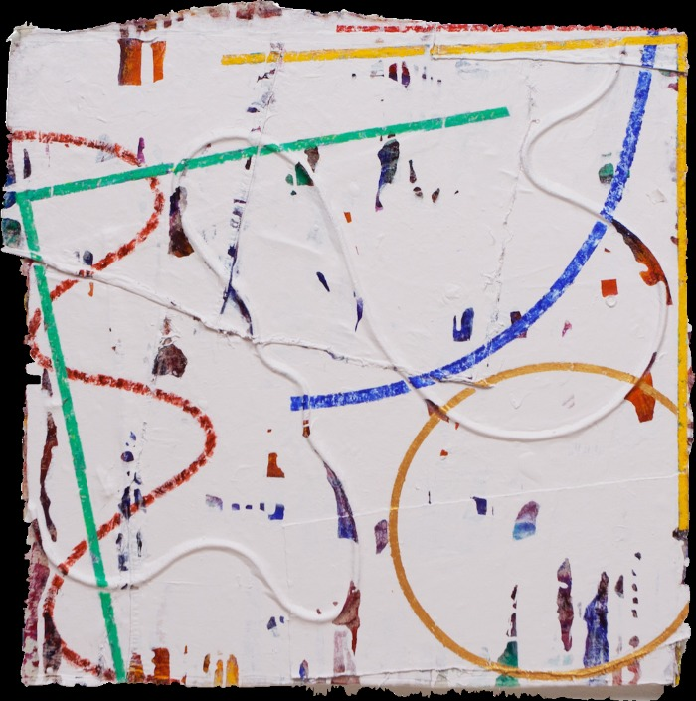
Untitled GSp1 (AWID_BOMgsp15)
acrylic and embedded rope on canvas

Slide 15
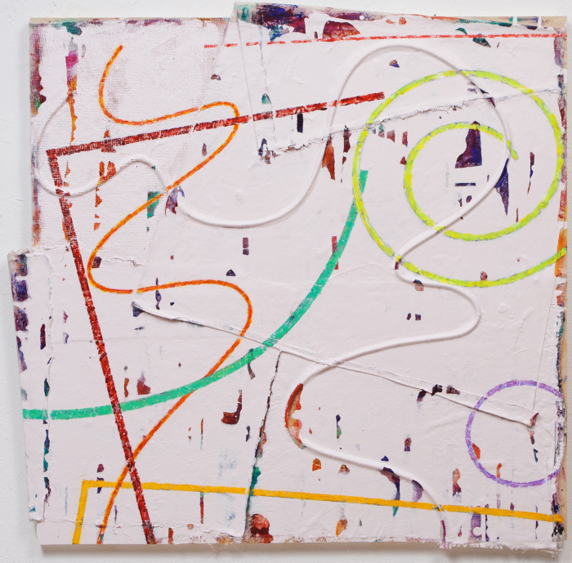
GSp16 (AWID_BOMgsp16)
acrylic, embedded rope, laminated canvas on wood panel

Slide 16
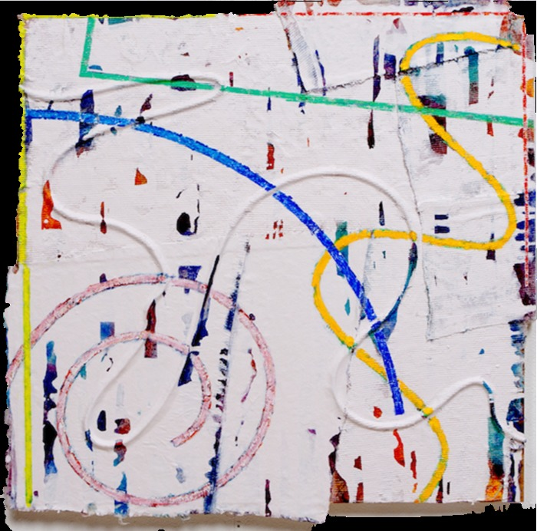
PSp 1 (AWID_BOMpsp16)
acrylic, embedded rope, laminated canvas on wood panel

Slide 17
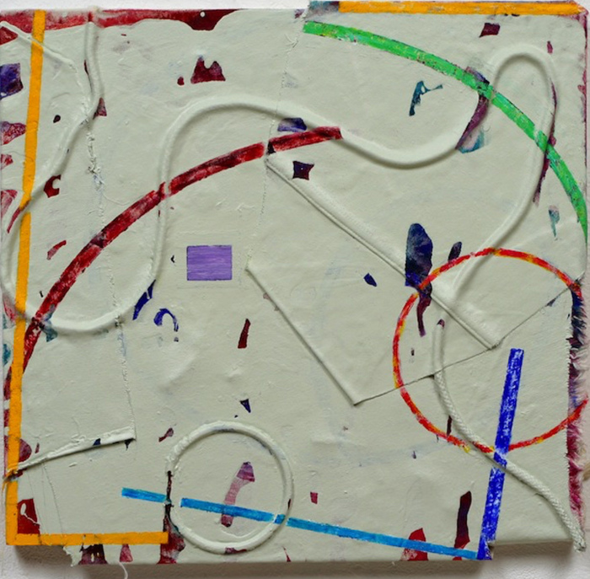
RC2 (AWID_BOMrc214)
acrylic, embedded rope, laminated canvas on wood panel

Slide 18
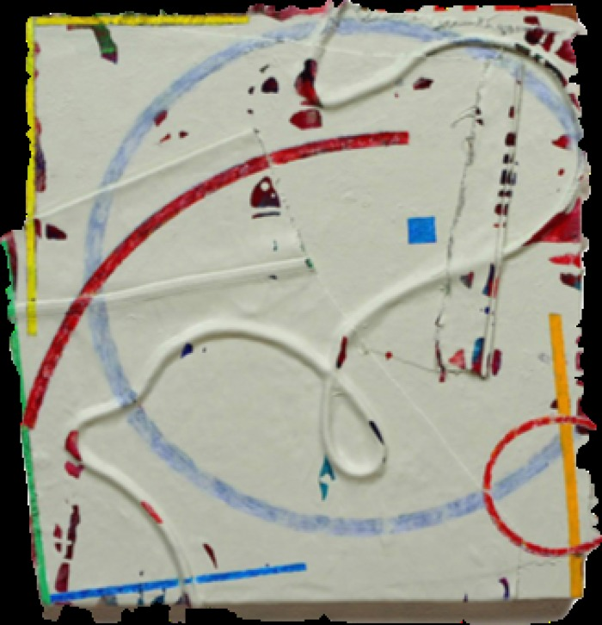
Untitled Ap14 (AWID_BOMuap14)
acrylic and embedded rope on canvas

Slide 19
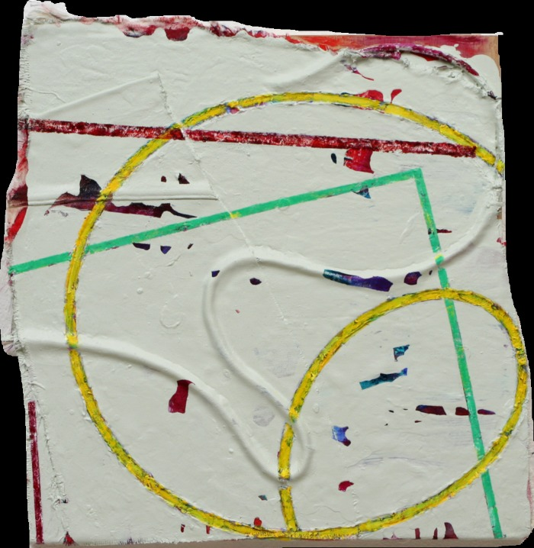
Untitled MA (AWID_BOMuma14)
acrylic on laminated canvas and cord

Slide 20
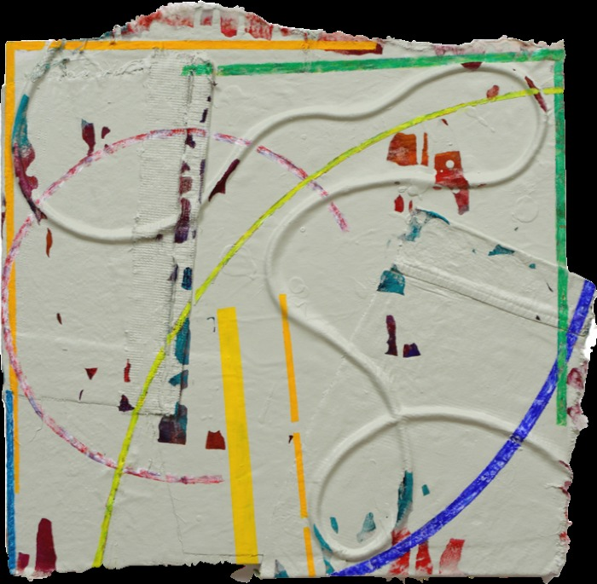
Untitled My-14 (AWID_BOMumy14)
acrylic and rope on canvas

Slide 21
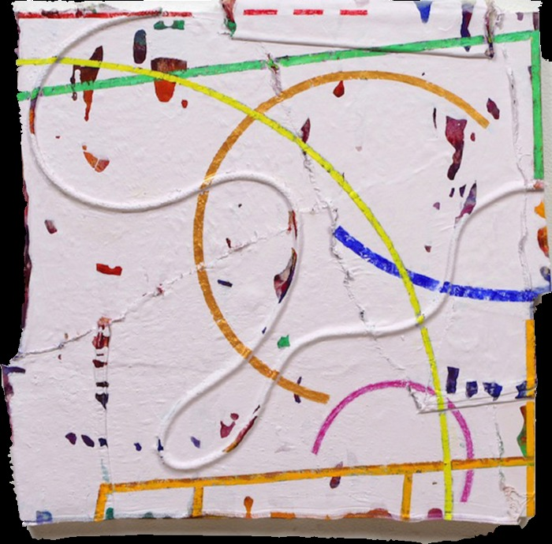
Untitled Sq 1 (AWID_BOMunt14)
embedded rope, laminated canvas on wood panel

Slide 22
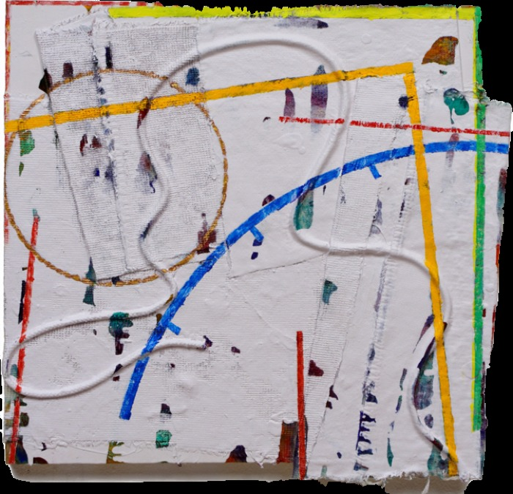
Untitled P1-14 (AWID_BOMup114)
acrylic and embedded rope on canvas

Slide 23
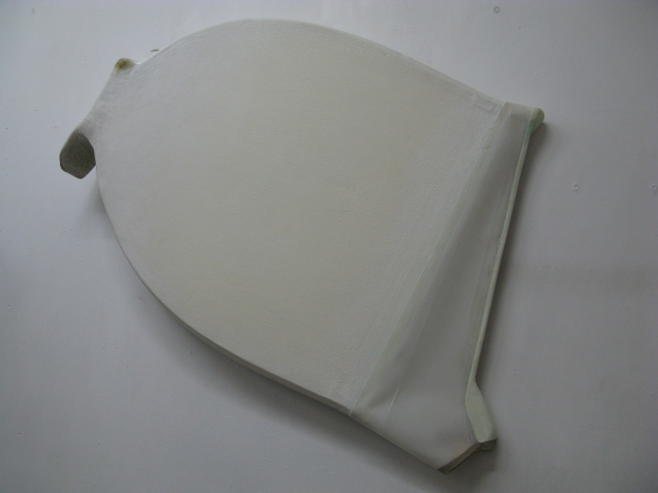
Jarak (AWID_CSLjar12)
Acrylic on Shaped Canvas

Slide 24
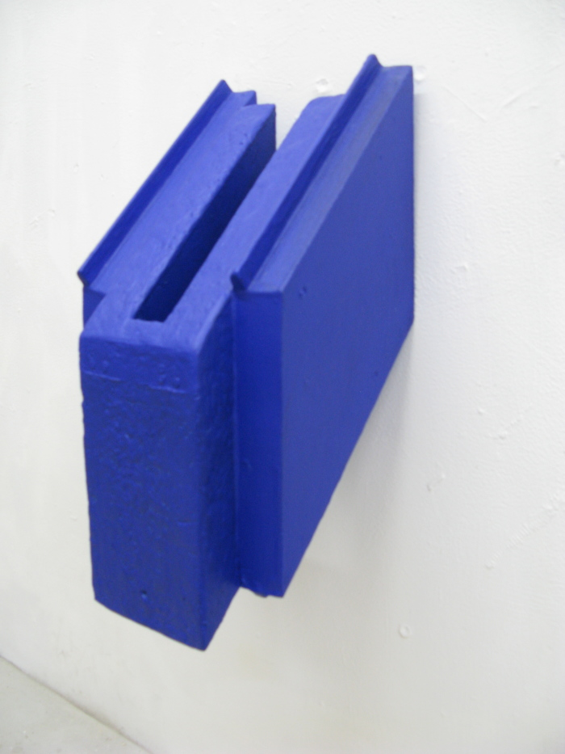
Nam (Shaman Dance) (AWID_CSLnam11)
Materials include: Wood, Acrylic, Rabbit Skin Glue

Slide 25
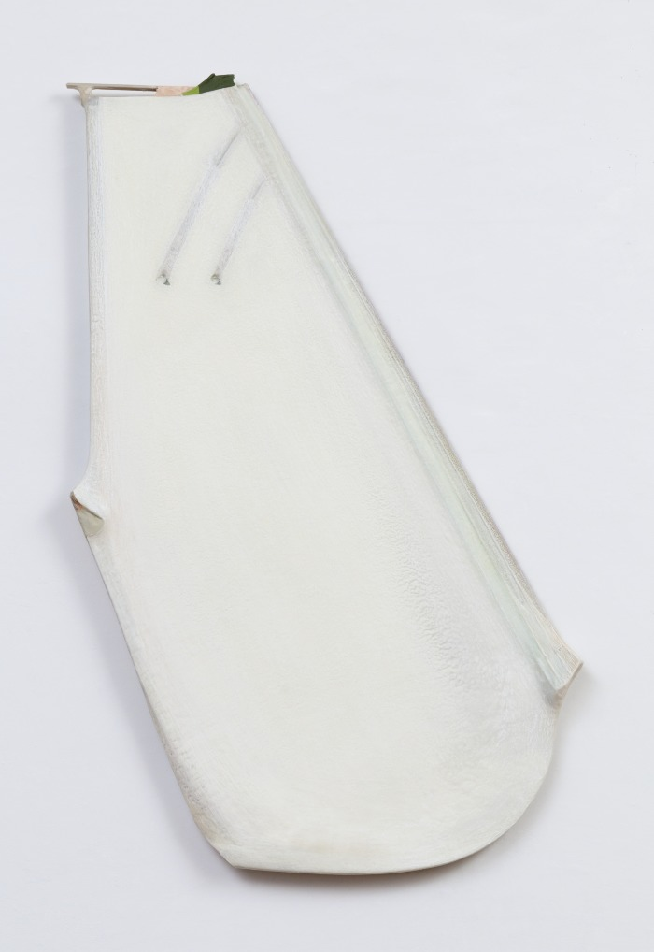
Oja-Rak (AWID_CSLoja13)
Acrylic on shaped canvas, rabbit skin, glue

Slide 26
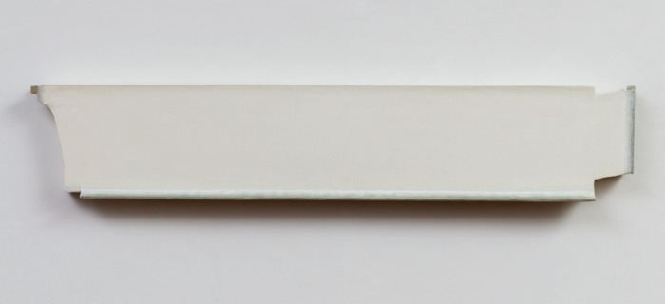
One (AWID_CSLone12)
Acrylic on Shaped Canvas

Slide 27
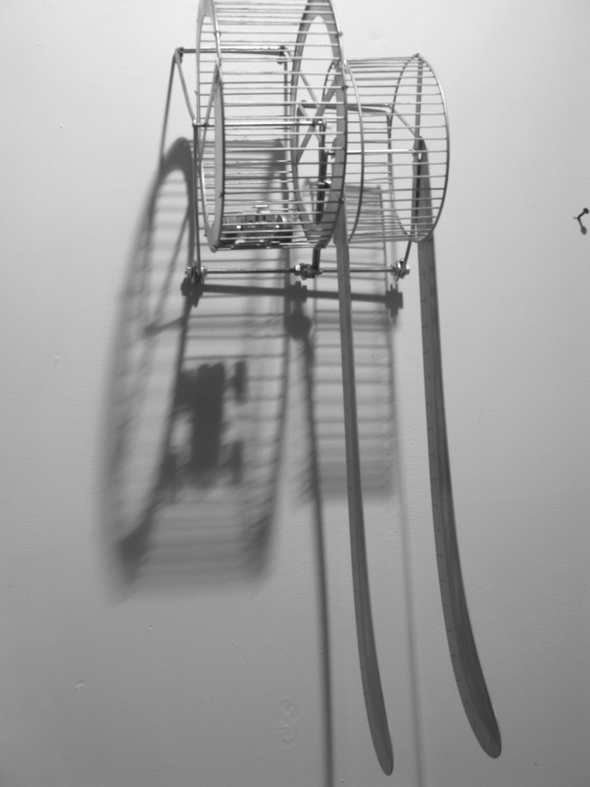
Running Wall (Squirrel) (AWID_CSLrun05)

Slide 28
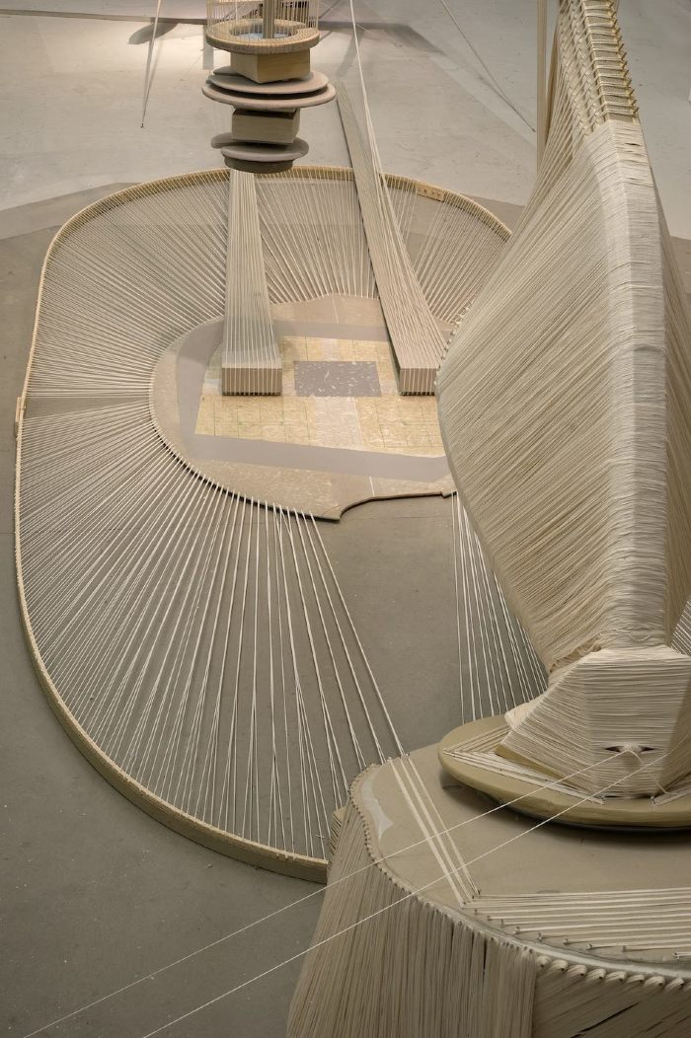
Ta-Rae (AWID_CSLtar)
1500 Yards Korean Cotton threads

Slide 29
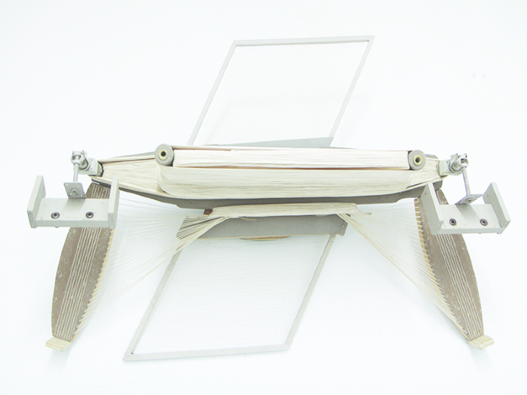
Ta-Rae (AWID_CSLtar95 )
Materials include: acrylic, wood, paper, rice paper, thread, U.V.L.S gel

Slide 30
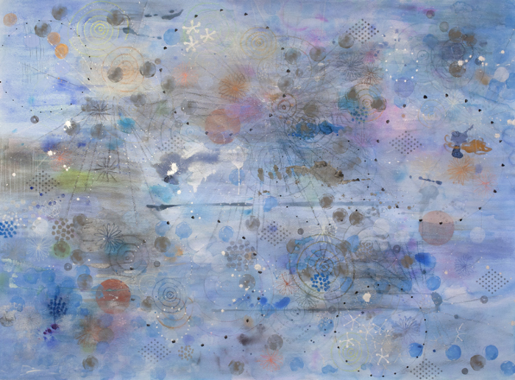
A Flask of Dews (awID_DJHKafl14)
Mixed media on arches paper

Slide 31
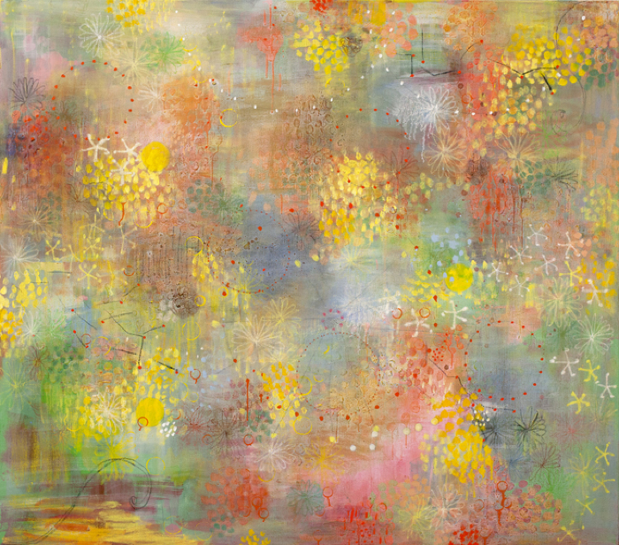
Autumn Colors (AWID_DJHKaut14)
oil on canvas

Slide 32
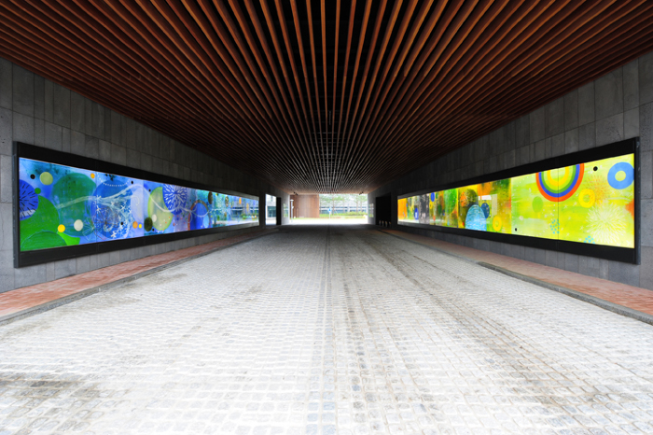
Hope Cloud (awid_DJHKhop11)
Original glass paint with backlit LED panel. Public artwork

Slide 33
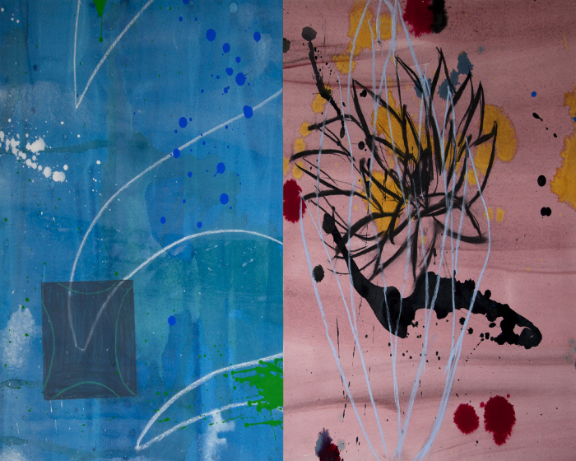
Lotus (AWID_DJHKlot95)
Paper, mixed media

Slide 34
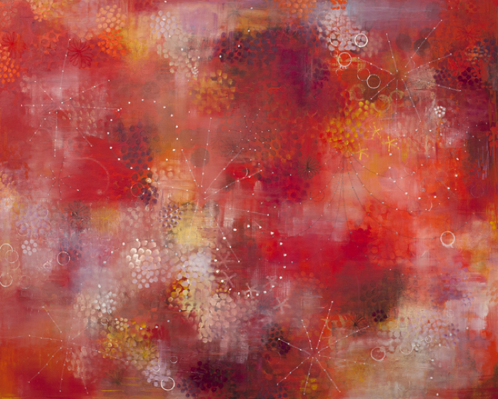
Pomerol (AWID_DJHKpom14)
Oil on cavas

Slide 35
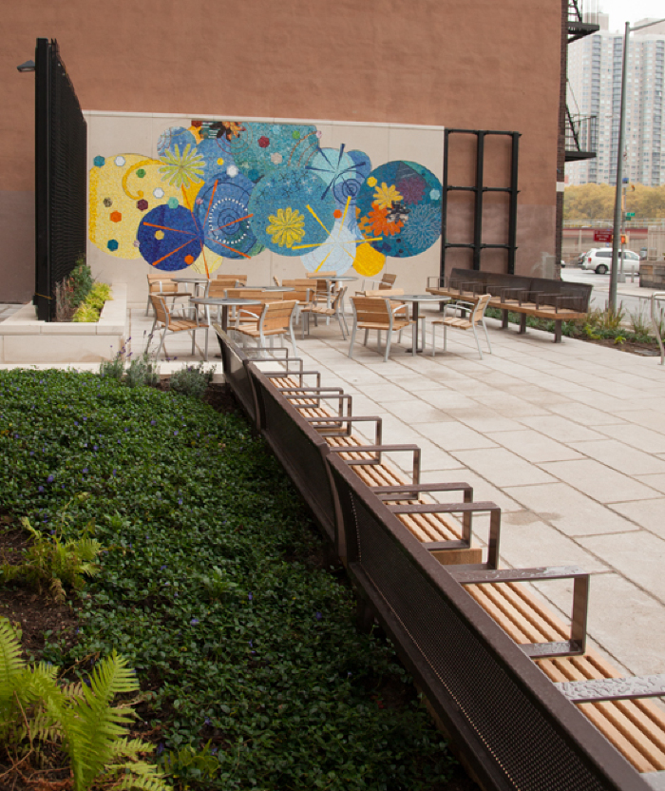
Whimsical Rays (awid_DJHKwhi13)
(Needs location information)

Slide 36
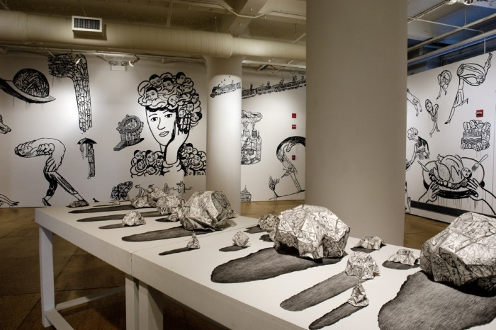
Designing Egos, Wall painting, animation & table installation (AWID_EKdes2010)

Slide 37
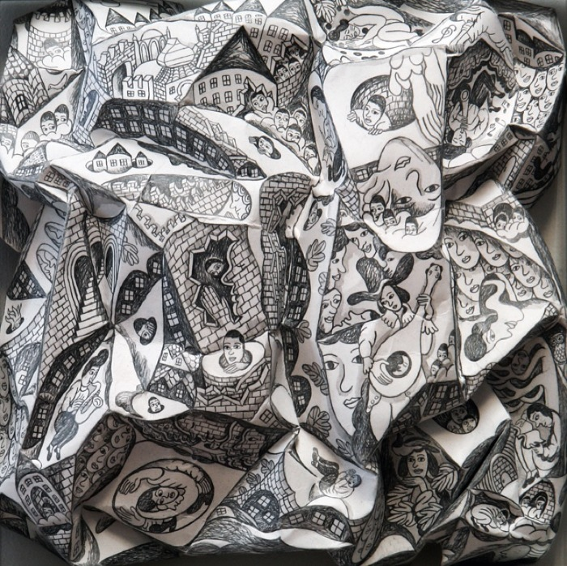
No. 2 "Il vecchio castello" (AWID_EK_no22012)
Graphite, ink on structured paper

Slide 38
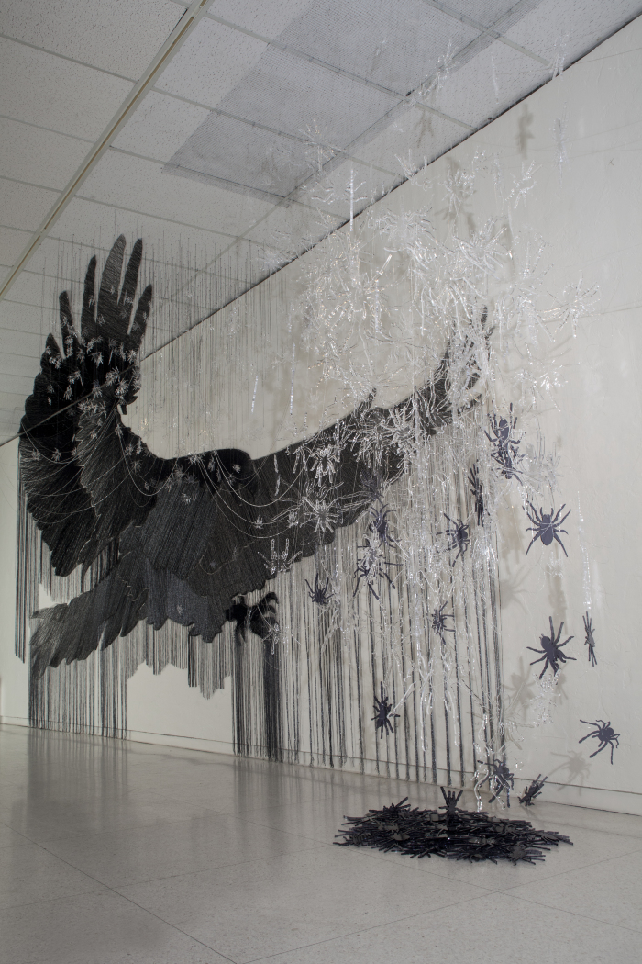
Game of Artifice (AWID_gam14)
Threads and Pins on wall IMAS (Internation Museum of Art and Science) Solo Show 2015

Slide 39
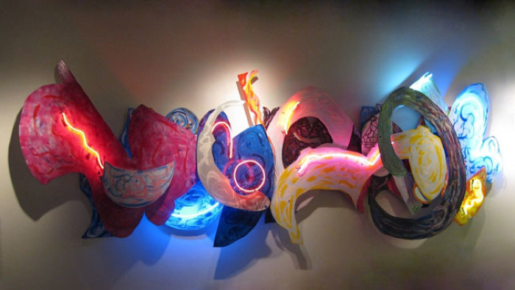
Spring Time in Brooklyn (AWID_HNAspr09)

Slide 40
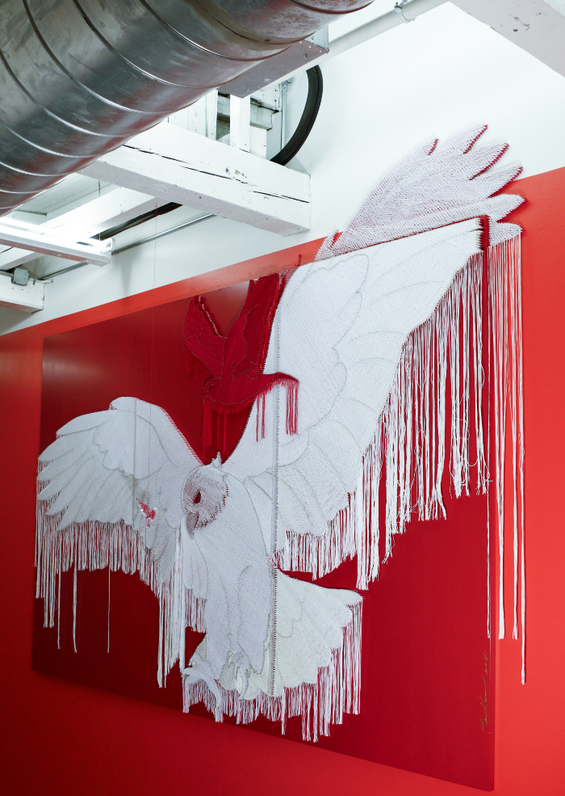
Another Freedom (AWID_HRano15)
MASS MoCA - Solo Show 2015 Pins, Threads on Wooden Panel

Slide 41
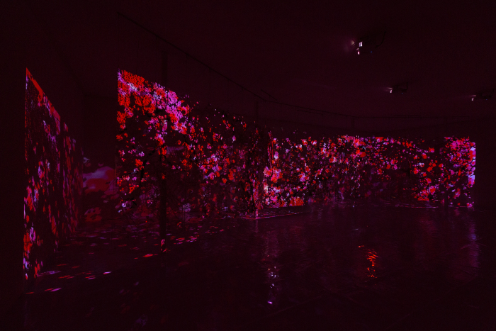
Becoming Again (AWID_HRbec14)
Paper Buttons, Beads, Crystals, and Pins on Plexiglas

Slide 42
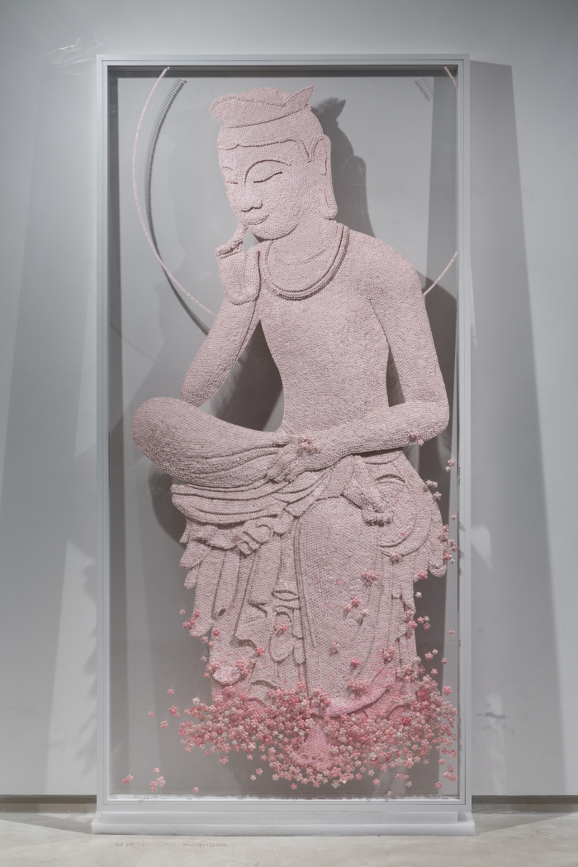
Contemplation Time (AWID_HRcon14)
Paper Buttons, Beads, and Pins on Plexiglas Leila Heller Gallery - Solo Show 2014 -> Asian Art Week 2016 (Gallery Korea)

Slide 43
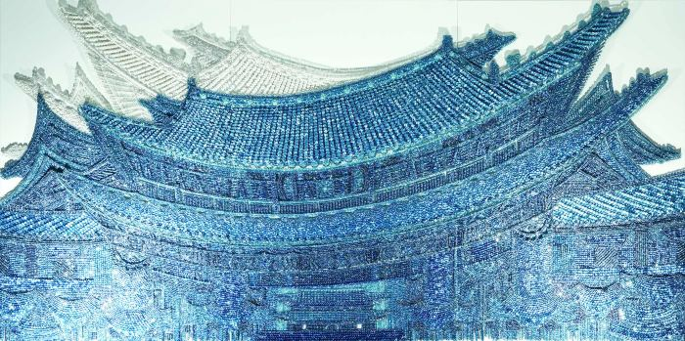
East Wind from old Palace (AWID_HReas12)
Buttons, Pins, Bead, and Wooden Panel

Slide 44
East Wind_K(LT) (AWID_HReas15)
Buttons, Beads, and Pins on Wooden Panel Installed at Pullman Kaifeng Hotel

Slide 45
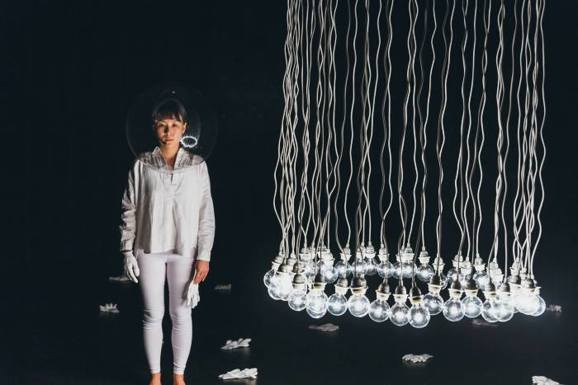
50 Bulbs (AWID_HRL50b17)

Slide 46
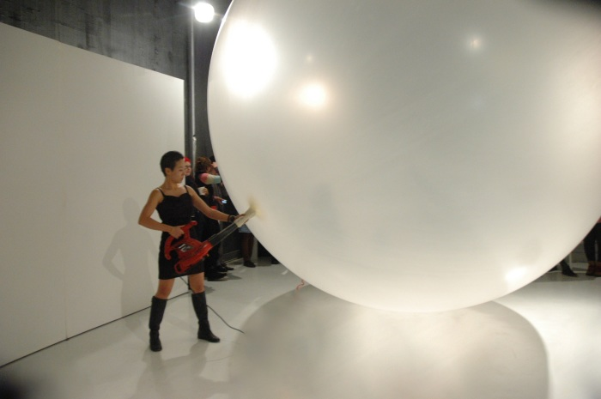
Blow It!!! (AWID_HRLBi12)

Slide 47
In Braids (AWID_HRLIB11)

Slide 48
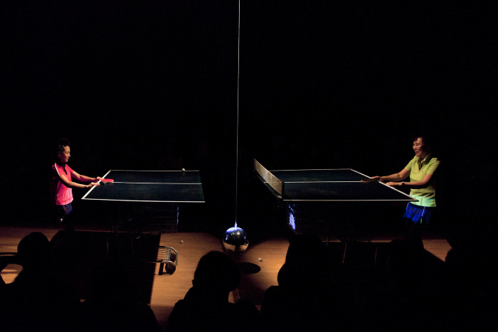
In Sook (AWID_HRLIS12)

Slide 49
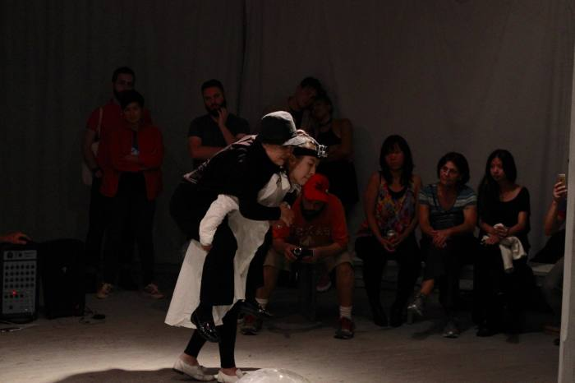
In Sook (AWID_HRLIS15)

Slide 50
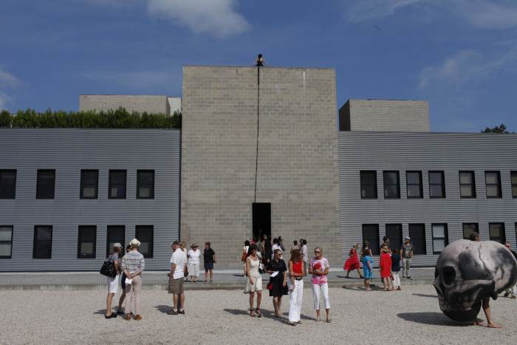
I Have Been Told Not to Move (AWID_HRLIWT11)

Slide 51
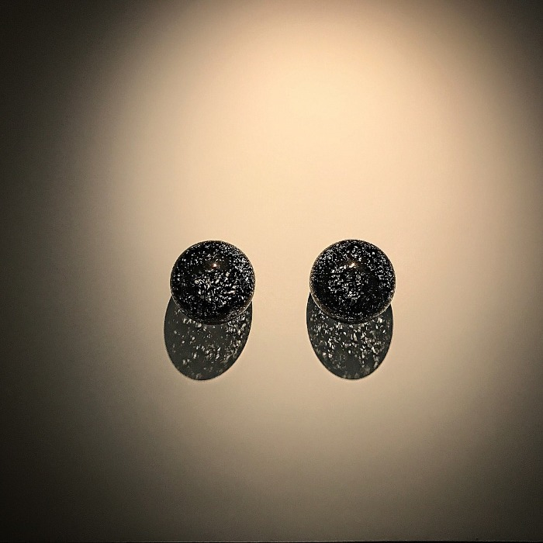
They See Us We Hear Them (AWID_HRLYSU17)

Slide 52
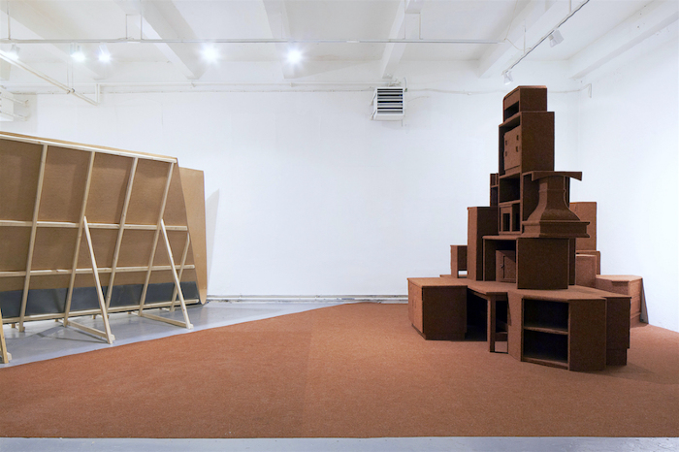
Community (AWID_HSJ)
Household furniture, carpe Dimensions variable

Slide 53
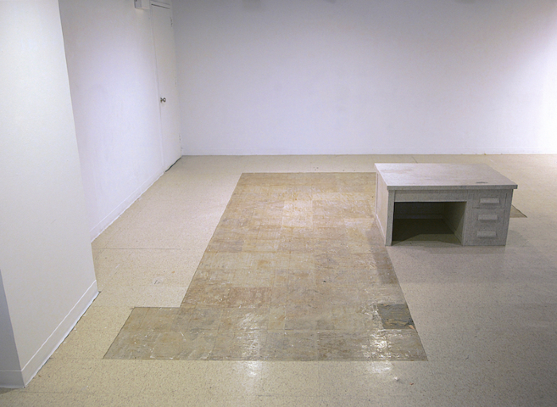
Bunker (AWID_HSJbuk13)
Ddesk, linoleum tiles Dimensions variable

Slide 54
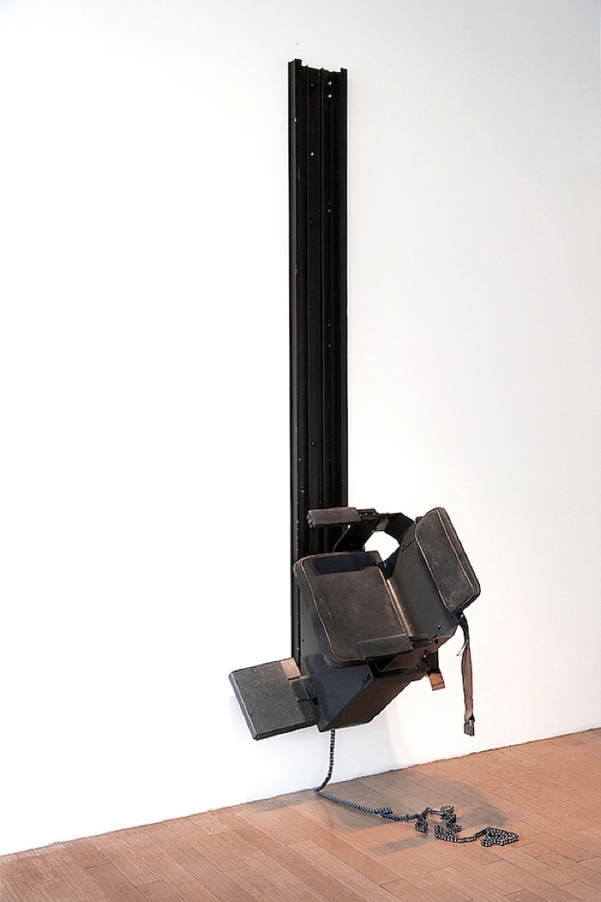
Chair (AWID_HSJcha14)
The stair lift that had been used for 30 years and found from a local craigslist in Denver was installed on the gallery wall vertically. I attempted to highlight the vertical sculptural aspect of the object rather than its original functionality.

Slide 55
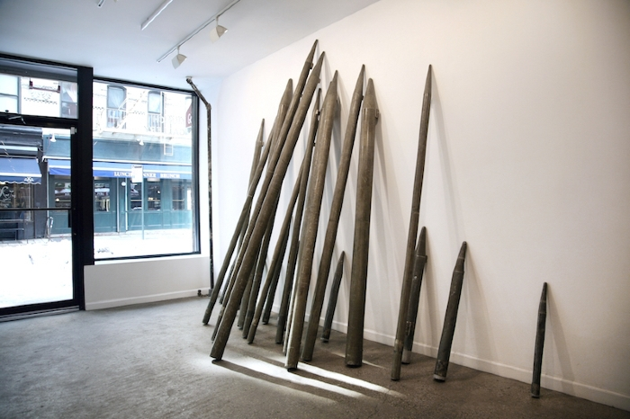
Instrument (AWID_HSJins14)
Upside down musical instrument “Pipe organ” resembles military instrument "missile”. This work explores to form new meanings and perceptions towards objects by removing them from its original setting and combining it in something unexpected.organ pipes, Dimensions Variable

Slide 56
Marbleous (AWID_HSJmar11)
Found household furniture, faux marble tiles

Slide 57
Pied Piper (AWID_HSJoie16)
British police baton

Slide 58
Prayer Rug (AWID_HSJpra14)
Military ribbons (found) mounted on fabric.

Slide 59
Union (AWID_HSJuni16)
Eemergency survival blanket, flag pole Dimensions variable

Slide 60
Wishing well (AWID_HSJwish16)
found old plastic tiles, foam board, grout, coins

Slide 61
Atom's Rib (awid_JPato10)
Welded steel

Slide 62
Dark Star (AWID_JPdar08)
welded steel

Slide 63
Eternal Moment (awID_JPete11)
Welded steel

Slide 64
Eternal Moment (AWID_JPete11)
Welded steel

Slide 65
In Memory's Lair (AWID_JPinm10)
welded steel

Slide 66
In Stillness They Dance (AWID_JPins09)
welded steel

Slide 67
Lost in a Finite Space (AWID_JPlos11)
welded steel

Slide 68
Myth's Sway (AWID_JPmyt09)
welded steel

Slide 69
Myth's Sway (AWID_JPmyt09)
welded steel

Slide 70
Notes from the Stars (AWID_JPnot07)
Public sculpture located at Seoul Institute of the Arts in Ansan, South Korea. Made of stainless steel.

Slide 71
Shared Destinies (AWID_JPsha15)
welded steel

Slide 72
"Simple Ties" (AWID_JPsim12)
welded steel

Slide 73
Unintended Consequences (AWID_JPuni2010)
welded steel

Slide 74
Cherry Blossoms (AWID_JRche12)

Slide 75
The Flesh and the Book (AWID_JRfle13)

Slide 76
Niagara (AWID_JRnia08)
single channel video, TRT 1'45"

Slide 77
Notes (AWID_JRnot07)
Eight-Channel Video installation with sound. 2 min 17 sec Sound composed by Elliott Sharp.

Slide 78
The Perfect Moment (AWID_JRthe15)
The two-channel video depicts an old veteran dancer talking about her experiences. Her story has three parts: First, she talks about her experience as an only-audience of a famous modern dancer's solo piece. Second, she describes her first debut performance. She tries to describe the movements orally in detail while a young dancer simultaneously re-enacts the story in a bright empty studio. At last, the old veteran dancer recalls the perfect moment that she has experienced in her first solo performance. And again, she tries to describe the moment as detailed as possible while the young dancer still re-enact the moment and the movements that she describes. The story and the dance however do not perfectly match throughout the piece. There are discrepancies: first, between the older dancer's story and the actual dance she performed long ago; secondly, between the younger dancer's rendition on the perfect moment and the older dancer's recollection of the moment and so on. While younger dancer does not replicate the original moment precisely, it still becomes her own perfect moment. Memory cannot be perfectly re-presented or re-enacted. The story of a person cannot be perfectly re-presented, nobody can re-enact the moment that a person experienced either. It is impossible; however, the perfect moment exists. It is impossible to re-create, re-enact, re-present but such a moment exists with everyone's experience.

Slide 79
Celadon Remnants (AWID_JScel08)

Slide 80
Chemical Balance III (AWID_JSche09)
Prescription bottles, mirror and epoxy, fluorescent lights 5 units, from 18 to 40 inches in diameter

Slide 81
Cut Outs and Suspended Seams (AWID_JScut04)
Commissioned by the Museum of Modern Art, New York for the exhibition Projects 81: Jean Shin

Slide 82
Dress Code (AWID_JSdre08)
Cut fabric (military uniforms and citizens’ clothes), Beva adhesive on 18 painted aluminum composite panels

Slide 83
Elevated (AWID_JSela17)
Installed at the Lexington Avenue–63rd Street station. Material: laminated glass, glass mosaic, and ceramic tile.

Slide 84
Everyday Monuments (AWID_JSeve09)
Sports trophies, painted cast and sculpted resins, projections Commissioned by the Smithsonian American Art Museum, Washington, D.C. for the exhibition, Jean Shin: Common Threads

Slide 85
Found Installation Series (AWID_JSfou02)
Digital c-print 20 in h x 16 in w; 16 in h x 20 in w Edition of 6 Found Installation (Seams, Tapes and Chords) Found Installation (Ribbons) Found Installation (Vinyl Rolls) Found Installation (Steel Rods)

Slide 86
Settings (AWID_JSset10)
Ceramic plates and tiles

Slide 87
Sound Wave (AWID_JSsou07)
Melted 78 rpm records on wooden armature

Slide 88
TEXTile (AWID_JStex06)
In collaboration with The Fabric Workshop and Museum, Philadelphia 22,528 recycled computer keycaps and 192 custom keycaps, fabric, customized active keyboard and interactive software, video projection and painted aluminum armatures

Slide 89
Days in New York – F Train (AWID_KLday_10-14)
Title: Days in New York – F Train Year of Production: 2011--‐2014, Type: 5--‐sync HD channel video installation, B/W, Sound Digital Dimension: 1min. 40sec. loop

Slide 90
Family Portrait (AWID_KLfam09)
Installation View at Brain Factory, Seoul, Korea, 2012 Type: HD Moving Image Medium: 4 prints from a master 157 Prints, Drypoint on Hahnemühle Copperplate bright white paper, B/W, Sound Digital Dimension: 44sec.

Slide 91
Fresh Pink (AWID_KLfre15)
Title: Fresh Pink Year of Production: 2015 Type: HD Moving Image, 520 Monoprint on Pink Post--‐it, Color, Sound Digital Dimension: 1min

Slide 92
Untitled – Grand Army Plaza. Brooklyn. NY. 03.09. (AWID_KLgra09)
HD Moving Image, 156 Prints, Drypoint on Hahnemühle Copperplate bright white paper Each print: 7 3⁄4 x 22 1⁄2 inches, B/W, Sound, 37sec. loop

Slide 93
Hana's Ride (AWID_KLhan14)
Title: Hana's Ride Year of Production: 2014 Type: HD Moving Image, 327 Drypoint print, B/W, Sound Digital dimension: 2min

Slide 94
Palgongsan Series (AWID_KLpal14)
2014, Five Channel Video Installation Five mini projectors, MDF boards, Dimensions Vary, B/W, Sound.

Slide 95
Walk (AWID_KLwal10)
Title: Walk – 2010 Year of Production: 2010, Type: HD Moving Image Medium: 198 prints, Drypoint on Hahnemühle Copperplate bright white paper, B/W, Sound, Digital Dimension: 1min.

Slide 96
Barbara at Café Folies-Bergère (AWID_KNGBCF18)
Oil, flashe, acrylic and xerox transfer on canvas

Slide 97
Dreamland II (AWID_KNGDII03)
Oil on linen

Slide 98
Grab It By the Papaya (AWID_KNGGib16)
Oil, flashe and acrylic ink on canvas

Slide 99
Morning Routine (AWID_KNGMR12)
Watercolor, gouache, linocut, collage and modeling clay on paper mounted on panel

Slide 100
Nebraska Suite No. 1: Half a Fig (AWID_KNGNS114)
Watercolor and gouache on paper

Slide 101
Nebraska Suite No.2: Bubbly Eggplant (AWID_KNGNS214)
Watercolor and pigment pen on paper

Slide 102
Nebraska Suite No.3: Cornhusker State (AWID_KNGNS315)
Colored pencil, acrylic ink and gouache on paper

Slide 103
Self Portrait with Ermine (AWID_KNGSPE18)

Slide 104
Wave of Mutilation (AWID_KNGWM12)
Custom wallpaper, oil on canvas and tempera on drywall

Slide 105
Luna & Thousand River (AWID_LCSlun14)
Kinetic, Video, 1000Yard Korean Cotton Threads

Slide 106
Golden Peaches of Samarakand (AWID_MHKgol99)
Oil pastel on chalkboard Courtesy of the artist and Art Projects International, New York.

Slide 107
Postman (AWID_MHKpos)
Oil pastel on chalkboard Courtesy of the artist and Art Projects International, New York.

Slide 108
Preparing Kimchi (AWID_MHKpre00 )
Oil pastel on chalkboard, LCD monitor. Courtesy of the artist and Art Projects International, New York.

Slide 109
Spring, Summer, Fall, and Winter (AWID_MHKspr14)
Oil pastel on chalkboard. Installation view, MYONG HI KIM: The New Four Seasons at Art Projects International, New York, 2015. Courtesy of Art Projects International, New York.

Slide 110
Arirang Mass Games (2018) (AWID_MNC_amg18)
An installation of paintings, digital prints, and new media, with a photographic print as a vinyl wall, Museum of Contemporary Art (MoCA) Busan, Korea Photo by: Lee Sang Uk

Slide 111
Dreaming Unification: Oori (우리) Protest for Peace (AWID_MNC_du1920)
Custom-made IKB paint, stencil, spray paint, sumi ink in canvas Photo by: Cyrus Feldman

Slide 112
Eat Chocopie Together (AWID_MNC_ect18)
100,000 Chocopie art installation for the audience to eat at the Busan Biennale 2018, sponsored by the Orion Co., Museum of Contemporary Art (MoCA) Busan, Korea Photo by: Lee Sang Uk

Slide 113
The 28 Days (AWID_RH28d15)
Paper Hangul buttons, Pins, Crystal, Beads on Plexiglas + Video on Monitor UNESCO Paris - Solo show 2015 -> Aisa Art Week 2015(Gallery Korea)

Slide 114
After Empty Me (AWID_RHaft13)
Abu Dhabi RoseWood Hotel Buttons, Pins, Beads on Wooden Panel

Slide 115
Rest II (AWID_RHres09)
Metal Buttons, Pins, Wooden Panel

Slide 116
The Beginning of The Bright (AWID_RHthe15)
UNESCO Paris - Solo show 2015 -> Aisa Art Week 2015(Gallery Korea) Paper Hangul Buttons, Pins, Beads on Plexiglas

Slide 117
Buddha Falling in Love (AWID_RWbud13)
Paper buttons, beads, pins on Plexiglas

Slide 118
Untitled (Pelvic Terrain) (AWID_SHBunt10)

Slide 119
Untitled (J L Wings) (AWID_SHBunt11)

Slide 120
Mountain God (AWID_SHC14)
Mixed media on wood panel

Slide 121
A countries (AWID_SHCaco90)
Tempera, graphite, acrylic paint on canvas

Slide 122
American Dream (AWID_SHCame93)
Lotto ticket, ball point pen, wood

Slide 123
American Pie (AWID_SHCame96)
Acrylic paint, silk screen print, wood

Slide 124
American Dream (AWID_SHCamer88)
Mixed media installation

Slide 125
Centrifugal (AWID_SHCcen99)
Acrylic paint on wood

Slide 126
Counting Up (AWID_SHCcou2010)
Video (ongoing)

Slide 127
Dreamscape (AWID_SHCdre11)
Mixed media on wood

Slide 128
Forever Young (AWID_SHCfor11)
Mixed media on wood panel

Slide 129
Korean Roulette (AWID_SHCkor92)
Mixed media on wood

Slide 130
Morning Calm (AWID_SHCmor99)
Mixed media outdoor installation

Slide 131
My America (AWID_SHCmya96)
Ceramic tile mural

Slide 132
Period (AWID_SHCper85)
Mixed media on paper

Slide 133
Repose (AWID_SHCrep15)
Mixed media on wood panel

Slide 134
RS-1 (AWID_SHCrs115)
Mixed media on paper

Slide 135
Their Korea (AWID_SHCthei)
Mixed media on wood

Slide 136
Trophy (AWID_SHCtro17)
Gouache on paper

Slide 137
Untitled (AWID_SHCunt83)
Tempera, graphite, wood

Slide 138
Below (AWID_SJJ)
cedar totems and oil Dimension is variable.

Slide 139
03 (AWID_SJJ0307)
Exhibition View

Slide 140
Chairs (AWID_SJJchair09)
About 120 chairs collected from 2000-2009 and lighting

Slide 141
Crossroads (AWID_SJJcro08)
Image from a one-hour installation and performance piece, Itaparica, Brazil In collaboration with a composer and clarinetist Derek Bermel Sponsored by SACATAR Foundation, US/Brazil

Slide 142
Nobody (AWID_SJJnob14)
218 frames found in New York and Seoul oil, acrylic, ink, fishing wire Collection of the Seoul Museum of Art

Slide 143
The Face of Heaven (AWID_SJJthe16)
LED lights through 304 holes on panel, 7 LED speed controllers, mixed media, 30 feet long bench, sound Sound: excerpts from “Elixir,” composer Derek Bermel + Boston Modern Orchestra Commissioned by Gyeonggi Museum of Art, Ansan, Korea.

Slide 144
To the Unknown God (AWID_SJJtot07)
Arko Art Center

Slide 145
Wishing Bells/To Protect & To Serve (AWID_SJJwis09)
108 bronze bells, 9 cedar columns, stainless trellis, lighting, plaza design at the Public Plaza Entrance of the LA Metro Detention Center, Los Angeles Commissioned by City of Los Angeles Department of Cultural Affairs, Public Art Division, Los Angeles

Slide 146
Witness (AWID_SJJWit17)
Site-specific installation wood, mixed media, sound Commissioned by Forum Schlossplatz, Aarau, Switzerland

Slide 147
Bottari, The Island (AWID_SJKbot11)
Used Japanese clothes, used Korean bedcovers, Dimensions variable, Site specific 8 Bottari installation at Palazzo Fortuni, Venice, Installation view

Slide 148
Deductive Object (Bottari) (AWID_SJKded07)
Deductive Object (Bottari cart) 19th C. Baguette Cart (France), 8 bottaris - used bed clothes and used clothes, bungee cords 100cm high x 97cm wide x 73cm deep 2007 Deductive Object (Bottari) Single bottari - red embroidered used bed clothes, and used clothes 2007 Deductive Object (Bottari cart) 19th C. Baguette Cart (France), 8 bottaris - used bed clothes and used clothes, bungee cords 106cm high x 100cm wide x 63cm deep 2007

Slide 149
Encounter - Looking into Sewing (AWID_SJKenc88)

Slide 150
Blue Zone (AWID_SKblu13)

Slide 151
Enfolding 280 Hours (AWID_SKenf09)

Slide 152
Untying Space, CUAM (AWID_SKK)

Slide 153
Untying Space, Leeum Samsung Museum (AWID_SKKunt10)

Slide 154
Untying Space (AWID_SKKunt12)
Title: Untying Space Year of Production: 2012 Dimensions (in): varies Collaborators & Roles: Curated by Mami Kataoka Location or Site: Installed for the "Phantom of Asia" international group show at Asian Art Nuseum, San Francisco Types: Drawings, Installation Others: Masking tape, adhesive vinyl, metal bar Style: abstract, Cartoonesque Subject Matter: Dynamic Energy, Geometric

Slide 155
Peeing Appealing (AWID_SKpee05)

Slide 156
Sewing Space (AWID_SKsew13)

Slide 157
Space Take Out (AWID_SKspa15)
Asian Art Biennale 2015, Night View

Slide 158
Study from Liquid Drawing (AWID_SKstu13)

Slide 159
Times Composed III (AWID_SKtim08)

Slide 160
Times Composed (AWID_SKtim11)

Slide 161
Untying Space, The New Children's Museum, Interaction piece (AWID_SKunt09)

Slide 162
Aphrodisiac_05 (AWID_SMA_A05)
Color on mulberry paper

Slide 163
Aphrodisiac_08 (AWID_SMA_A08)
Ink and color on mulberry paper

Slide 164
Coalesced_01 (AWID_SMA_C1)
Ink and color on mulberry paper

Slide 165
Evolutionary Impulse_02 (AWID_SMA_I02)
Ink and color on mulberry paper

Slide 166
Its Inside Is Bigger Than Its Outside (AWID_SMA_IIIBTIO2)
Ink and color on mulberry paper

Slide 167
Its Inside Is Bigger Than Its Outside_butterflies_03 (AWID_SMA_IIIBTIOB)
Ink and color on mulberry paper

Slide 168
Portrait of Peony (AWID_SMA_PP)
Ink and color on mulberry paper

Slide 169
Portrait of Peony_color (AWID_SMA_PPc)
ink and color on mulberry paper

Slide 170
Scar, memory and transcendence_2 (AWID_SMA_SMT)
Ink and color on mulberry paper, mounted as a scroll

Slide 171
Voyage (AWID_SMA_V)
Ink, color and pigment on mulberry paper

Slide 172
Shanghai Black 1 (AWID_SSJsha14)
mixed media on wood panels

Slide 173
Birch, Lacebark Pine , and Bamboo (AWID_TSKblb)

Slide 174
Cornucopia (AWID_TSKcor09)

Slide 175
Mountain Tao's Right Angle (AWID_TSKmou11)

Slide 176
7.2cm North East Asia (AWID_TSKnor10)

Slide 177
Notebook 2 (AWID_TSKnot)

Slide 178
Pi's Window :-∞+∞ (AWID_TSKpis03)

Slide 179
Pi's Window (AWID_TSKpis12)

Slide 180
Self Portrait (AWID_TSKsel11)

Slide 181
7.2 cm π (AWID_TSKsev08)

Slide 182
The Cup (AWID_TSKthe93)

Slide 183
Afternoon Calm (AWID_VJE_aft18)

Slide 184
Blue Birds in Hands (AWID_VJE_blu18)

Slide 185
Five Twenty Two (AWID_VJE_ftt18)
25 unique single-channel videos on 7” tablets, music composed by John Driscoll, TRT 5:22 loop (each)

Slide 186
Hometown Hero (Chink) (AWID_VJE_hom_1)
Single channel video, soft sculpture, hand upholstered recliner, uphostery fabric, TRT 11:31

Slide 187
Miss America (AWID_VJE_mis17)
Nylon stocking, acrylic paint, molded plastic jar

Slide 188
Pretty Bird in Hands (AWID_VJE_pbi18)

Slide 189
Thinly Worn (AWID_VJE_thi17)
TRT 9:29

Slide 190
Wedding Day (AWID_WSK77)

Slide 191
A Door in the Forest (AWID_WSKado16)

Slide 192
The Muse I (AWID_wskmus17)

Slide 193
River to my Pond (AWID_wskriv16)

Slide 194
Silent guitar (AWID_wsksil)

Slide 195
The Muse IV (AWID_WSKthe16)

Slide 196
The Muse II (AWID_wskthe17)

Slide 197
Body Drama (AWID_XCbod11)

Slide 198
de la Cruz Shoot (AWID_XCdel11)
Live film shoot as installation

Slide 199
Portal (AWID_XCpor10)

Slide 200
Ring (AWID_XCrin10)

Slide 201
Surveil (AWID_XCsur14)

Slide 202
Surveil (AWID_XCsur15)

Slide 203
Untitled (AWID_XCunt12)

Slide 204
Precis (AWID_YMMpre09)
Watercolor on paper

Slide 205
Some Sense of Order 20131112 (AWID_YMMsom13)
Oil on linen

Slide 206
Some Sense of Order 20131120 (AWID_YMMsom13)
Oil on linen

Slide 207
Some Sense of Order 20150406 (AWID_YMMsom15)
Oil on linen

Slide 208
Some Sense of Order 201703028 (AWID_YMMsom17)
Oil on linen

Slide 209
Some Sense of Order 20150430 (AWID_YMMsom215)
Oil on linen

Slide 210
There it is our homeland, my dear (AWID_YMMthe09)
Screen print in light box

Slide 211
Untitled (Disuse) (AWID_YMMunt07)
Light box

Slide 212
Untitled (Secrete saliva) (AWID_YMMunt08)
Watercolor on paper

Slide 213
Untitled (You remain) (AWID_YMMunti08)
Watercolor on paper

Slide 214
After Love (AWI_HRaft14)
Shell Buttons and Pins on Wooden Panel Leila Heller Gallery - Solo Show 2014

Slide 215
Another Myself (AWI_RHano13)
Buttons, Pins, Beads, Threads on Wooden Panel

Slide 216
Reverberation (YMM_rev09)
Watercolor on paper

Slide 217
Taxonomy of Saints (YMM_tax09)
Watercolor on paper

Slide 218
Untitled (In layers) (YMM_unt07)
Light box

